Slide 1
Lecture 4-5
CSE202: OBJECT ORIENTED PROGRAMMING

Slide 2
Outline
Structures, Unions and Classes
Enumeration
Inline and Non-inline member functions

Slide 3



Why Use Structures?
Quite often we deal with entities that are collection of dissimilar data types.
For example, suppose you want to store data about a car. You might want to store its name (a string), its price (a float) and number of seats in it (an int).
If data about say 3 such cars is to be stored, then we can follow two approaches:
  Construct individual arrays, one for storing names, another for storing prices and still another for storing number of seats.
  Use a structure variable.

Slide 4
Introduction
Structures are derived data types
Structures
  Structure is a group of data items of different data types held together in a single unit.
  Collections of related variables under one name
    Can contain variables of different data types
  Commonly used to define records to be stored in files.

Slide 5
Structure
There are three aspects of working with structures:
  Defining a structure type
  Declaring variables and constants of newly created type
  Using and performing operations on the objects of structure type

Slide 6
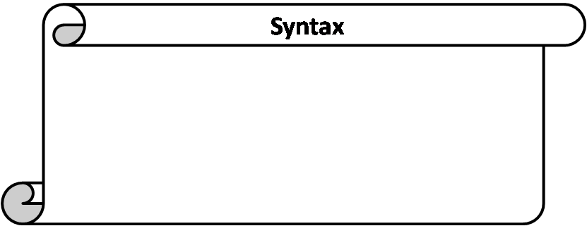
Structure Definition
struct sname {
type var1;
type var2;
type var3;
.
.
type varN;
};
struct is a keyword to define a structure.
sname is the name given to the structure/structure tag.
type is a built-in data type.
var1,var2,var3,…..,varN are elements of structure being defined.
; semicolon at the end.

Slide 7
Structure Definitions
Example:
      struct car{
      char n[20];
      int seats;
      float price
      };
  struct keyword introduces the definition for structure car
  car is the structure name or tag and is used to declare variables of the structure type
  car contains three members of type char, float, int
    These members are name, price and seats.
No variable has been associated with this structure
No memory is set aside for this structure.

Slide 8
Structure Definitions
struct information
  A structure definition does not reserve space in memory .
    Instead creates a new data type used to define structure variables
Defining variables of structure type
  Defined like other variables:
      Car myCar1,mycar2…
  Can use a comma separated list along with structure definition:
      struct car{
      char n[20];
      int seats;
      float price;
      } myCar;
At this point, the memory is set aside for the structure variable myCar.

Slide 9
Structure is a data type in which
A elements must have same data types
B elements may have different data types
C elements must have different data types
D none of these

Slide 10
Structure is a data type in which
A elements must have same data types
B elements may have different data types
C elements must have different data types
D none of these

Slide 11
A structure is a collection of
A homogenous e elements
B heterogenous elements
C homogenous elements and heterogenous elements

Slide 12
A structure is a collection of
A homogenous e elements
B heterogenous elements
C homogenous elements and heterogenous elements

Slide 13
How the members are stored in memory
Consider the declarations to understand how the members of the structure variables are stored in memory
struct car{
int seats;
float price;
}myCar,
Note: all members are stored in contiguous memory location in order in which they are declared.

Slide 14
How the members of the structure variables are stored in memory
1197
1198
1199
1200
1201
1202
1203
1204
1205
1206
1207
1208
1209
1210
1211
seats
price

Slide 15
Union
Union is similar as structure. The major distinction between them is in terms of storage.
In structure each member has its own storage location whereas all the members of union uses the same location.
The union may contain many members of different data type but it can handle only one member at a time union can be declared using the keyword union.

Slide 16

Example
A class is a very good example of structure and union in this example students are sitting in contiguous memory allocation as they are treated as a structure individually. And if we are taking the place of teacher then in a class only one teacher can teach. After leaving the first teacher then another teacher can enter.

Slide 17
Union Declaration
union item
{
int m;
float x;
char c;
}code;
This declare a variable code of type union item

Slide 18
Unions
Valid union operations
  Assignment to union of same type: =
  Taking address: &
  Accessing union members: .
  Accessing members using pointers: ->

Slide 19
#include <stdio.h>
union job{
char name[32];
float salary;
int worker_no;
}u;
main()
{
printf("Enter name:\n");
scanf("%s",&u.name);
printf("Enter salary: \n");
scanf("%f",&u.salary);
printf("Displaying\nName :%s\n",u.name);
printf("Salary: %.1f",u.salary);
}
Program using union.

Slide 20
Enter name Hillary
Enter salary 1234.23
Displaying
Name: f%Bary
Salary: 1234.2
Initially, Hillary will be stored in u.name and other members of union will contain garbage value. But when user enters value of salary, 1234.23 will be stored in u.salary and other members will contain garbage value. Thus in output, salary is printed accurately but, name displays some random string.

Slide 21
Which statement is true in case of memory allocation of members of union
A Memory is allocated for all variables.
B Allocates memory for variable which variable require more memory.
C Allocates memory for variable which variable require less memory.
D none of these

Slide 22
Which statement is true in case of memory allocation of members of union
A Memory is allocated for all variables.
B Allocates memory for variable which variable require more memory.
C Allocates memory for variable which variable require less memory.
D none of these

Slide 23
which is true in case of union
A require more memory space than Structure
B Declared with Struct Keyword
C require less memory space than Structure
D require more execution time than Structure

Slide 24
which is true in case of union
A require more memory space than Structure
B Declared with Struct Keyword
C require less memory space than Structure
D require more execution time than Structure

Slide 25
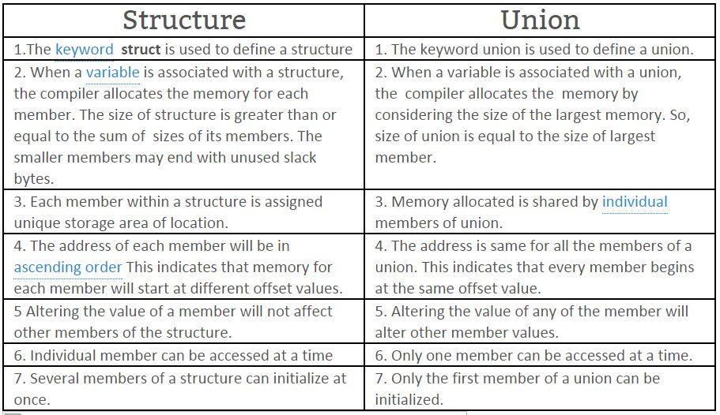

Slide 26
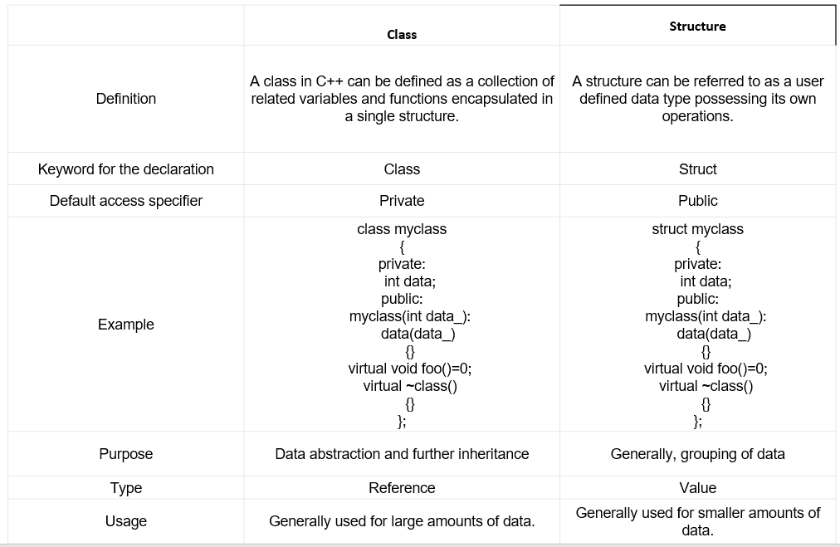

Slide 27
C structure differs from CPP class in regards that by default all the members of the structure are __________ in nature.
a. private
b. protected
c. public
d. None of these

Slide 28
C structure differs from CPP class in regards that by default all the members of the structure are __________ in nature.
a. private
b. protected
c. public
d. None of these

Slide 29
Difference between C structures and C++ structures
Member functions inside structure: Structures in C cannot have member functions inside structure but Structures in C++ can have member functions along with data members.
Direct Initialization: We cannot directly initialize structure data members in C but we can do it in C++.
#include <iostream>
using namespace std;
struct Record {
int x = 7;
};
int main()
{
Record s;
cout << s.x << endl;
return 0;
}

Slide 30
Using struct keyword: In C, we need to use struct to declare a struct variable. In C++, struct is not necessary. For example, let there be a structure for Record. In C, we must use “struct Record” for Record variables. In C++, we need not use struct and using ‘Record‘ only would work.
Static Members: C structures cannot have static members but is allowed in C++.
struct Record {
static int x;
};
int main()
{
return 0;
}
Note: This will generate an error in C but no error in C++.

Slide 31
Constructor creation in structure: Structures in C cannot have constructor inside structure but Structures in C++ can have Constructor creation.
sizeof operator: This operator will generate 0 for an empty structure in C whereas 1 for an empty structure in C++.
Data Hiding: C structures do not allow concept of Data hiding but is permitted in C++ as C++ is an object oriented language whereas C is not.
Access Modifiers: C structures do not have access modifiers as these modifiers are not supported by the language. C++ structures can have this concept as it is inbuilt in the language.

Slide 32
Enumeration (ENUM)
An enumeration is a user-defined type consisting of a set of named constants called enumerators
It serves to create data types, that is not limited to either numerical or character constants or Boolean values
The values that we specify for the data type must be legal identifiers
The syntax for declaring an enumeration type is:
enum typeName{value1, value2, ...};
The syntax to declare an enum is as follows:
  enum model_name
  {
  value1,
  value2,
  value3,
  . .
  };

Slide 33
Declaration of Enumerated Types
Consider the colors of the rainbow as an enumerated type:
enum rainbowColors{ red, orange, yellow, green, blue, indigo, violate };
The identifiers between { } are called enumerators
The order of the declaration is significant
red < orange < yellow
By default, the first enumerator has a value of 0
Each successive enumerator is one larger than the value of the previous one, unless you explicitly specify a value for a particular enumerator

Slide 34
Declaration of Enumerated Types
Why are the following illegal declarations?
enum grades{'A', 'B', 'C', 'D', 'F’};
enum places{1st, 2nd, 3rd, 4th};
What could you do to make them legal?
enum grades{A, B, C, D, F};
enum places{first, second, third, fourth};
They do not have legal identifiers in the list..

Slide 35
As with the declaration of any object
  Specify the type name
  Followed by the objects of that type
Given:
enum daysOfWeek { Sun, Mon, Tue,Wed, Thu, Fri, Sat }
Then we declare:
daysOfWeek Today, payDay, dayOff;

Slide 36
Assignment with Enumerated Types
Once an enumerated variable has been declared
  It may be assigned an enumerated value
  Assignment statement works as expected
payDay = Fri; // note: no quotes
// Fri is a value, a constant
Enumerated variables may receive only values of that enumerated type

Slide 37
Example 1:
main()
{
enum days{sun,mon,tues,wed,thur,fri,sat};
days day1,day2;
day1=sun;
day2=fri;
cout<<day1<<“\t”<<day2;
if(day1>day2)
{
cout<<“day1 comes after day2”;
}
else
{
cout<<“day1 comes before day2”;
}
}

Slide 38
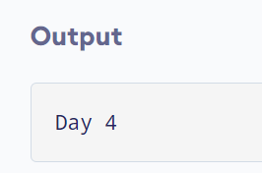
Example 2:
#include <iostream>
using namespace std;
enum week { Sunday, Monday, Tuesday, Wednesday, Thursday, Friday, Saturday };
int main()
{
week today;
today = Wednesday;
cout << "Day " << today+1;
return 0;
}

Slide 39
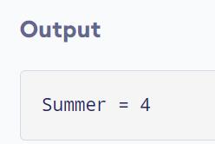
Example 3: Changing Default Value of Enums
#include <iostream>
using namespace std;
enum seasons { spring = 34, summer = 4, autumn = 9, winter = 32};
int main() {
seasons s;
s = summer;
cout << "Summer = " << s << endl;
return 0;
}

Slide 40
Find the output of below program
#include<iostream>
using namespace std;
enum color{
Black,
blue,
red
};
int main()
{
color obj = blue;
cout<<obj;
return 0;
}
(A) blue
(B) 2
(C) 1
(D) None of these

Slide 41
Find the output of below program
#include<iostream>
using namespace std;
enum color{
Black,
blue,
red
};
int main()
{
color obj = blue;
cout<<obj;
return 0;
}
(A) blue
(B) 2
(C) 1
(D) None of these

Slide 42
Find Output:
#include<iostream>
using namespace std;
enum color{
black=1,
blue,
red
};
int main()
{
color obj = blue;
cout<<obj;
return 0;
}
(A) blue
(B) Compilation Error
(C) 1
(D) 2

Slide 43
Find Output:
#include<iostream>
using namespace std;
enum color{
black=1,
blue,
red
};
int main()
{
color obj = blue;
cout<<obj;
return 0;
}
(A) blue
(B) Compilation Error
(C) 1
(D) 2

Slide 44
Find Output:
#include<iostream>
using namespace std;
enum color{
black=1,
blue,
red
};
int main()
{
color obj =yellow;
cout<<obj;
return 0;
}
(A) yellow
(B) Compilation Error
(C) 1
(D) 2

Slide 45
Find Output:
#include<iostream>
using namespace std;
enum color{
black=1,
blue,
red
};
int main()
{
color obj =yellow;
cout<<obj;
return 0;
}
(A) yellow
(B) Compilation Error
(C) 1
(D) 2

Slide 46
C++ inline function
C++ inline function is powerful concept that is commonly used with classes. If a function is inline, the compiler places a copy of the code of that function at each point where the function is called at compile time.
Any change to an inline function could require all clients of the function to be recompiled because compiler would need to replace all the code once again otherwise it will continue with old functionality.

Slide 47
#include <iostream>
using namespace std;
inline int Max(int x, int y) {
return (x > y)? x : y;
}
int main() {
cout << "Max (20,10): " << Max(20,10) << endl;
cout << "Max (0,200): " << Max(0,200) << endl;
cout << "Max (100,1010): " << Max(100,1010) << endl;
return 0;
}

Slide 48
Inline Member Function
To inline a function, place the keyword inline before the function name and define the function before any calls are made to the function. The compiler can ignore the inline qualifier in case defined function is more than 3-5 lines.
A function definition in a class definition is an inline function definition, even without the use of the inline specifier.
A member function that is defined inside its class member list is called an inline member function.
An equivalent way to declare an inline member function is to either declare it in the class with the inline keyword (and define the function outside of its class) or to define it outside of the class declaration using the inline keyword.

Slide 49
#include <iostream>
using namespace std;
class operation
{
int a,b,add;
public:
void get() // inline Member Function
{
cout << "Enter first value:";
cin >> a;
cout << "Enter second value:";
cin >> b;
}
void sum();
}s;
inline void operation :: sum()
{
add = a+b;
cout <<"Addition of two numbers: " << a+b;
}
Method 1: Inline Member Function
int main()
{
cout << "Program using inline function\n";
s.get();
s.sum();
return 0;
}
Method 2: Inline Member Function

Slide 50
Note: Inlining is only a request to the compiler, not a command. Compiler can ignore the request for inlining. Compiler may not perform inlining in such circumstances like:
1) If a function contains a loop. (for, while, do-while)
2) If a function contains static variables.
3) If a function is recursive.
4) If a function return type is other than void, and the return statement doesn’t exist in function body.
5) If a function contains switch or goto statement.

Slide 51
Inline functions provide following advantages:
1) Function call overhead doesn’t occur.
2) It also saves overhead of a return call from a function.
3) When you inline a function, you may enable compiler to perform context specific optimization on the body of function. Such optimizations are not possible for normal function calls. Other optimizations can be obtained by considering the flows of calling context and the called context.

Slide 52
When the function is defined inside a class, it is treated as ………………….
A) data function
B) inline function
C) non inline function
D) member variable

Slide 53
When the function is defined inside a class, it is treated as ………………….
A) data function
B) inline function
C) non inline function
D) member variable

Slide 54
Function which are declared in a class declaration and defined outside the class is known as……………….
A) inline member function
B) non-inline member function
C) static member function
D) dynamic member function

Slide 55
Function which are declared in a class declaration and defined outside the class is known as……………….
A) inline member function
B) non-inline member function
C) static member function
D) dynamic member function

Slide 56
True about inline function statements in C++
class A
{ public:
void func1()
{ }
void func2();
};
inline void A::func2()
{ }
Func1 is inline function
Func2 only is inline function
Func1 and Func2 both are inline functions
None of the above is inline

Slide 57
True about inline function statements in C++
class A
{ public:
void func1()
{ }
void func2();
};
inline void A::func2()
{ }
Func1 is inline function
Func2 only is inline function
Func1 and Func2 both are inline functions
None of the above is inline

